Slide 1
SLAC National Accelerator Laboratory
Understanding BIO Reviews, Workflows, and Approval Expectations
Kevin Brenton | Department Head | AHJ Services | Code Compliance | ES&H
June 1, 2026

Slide 2
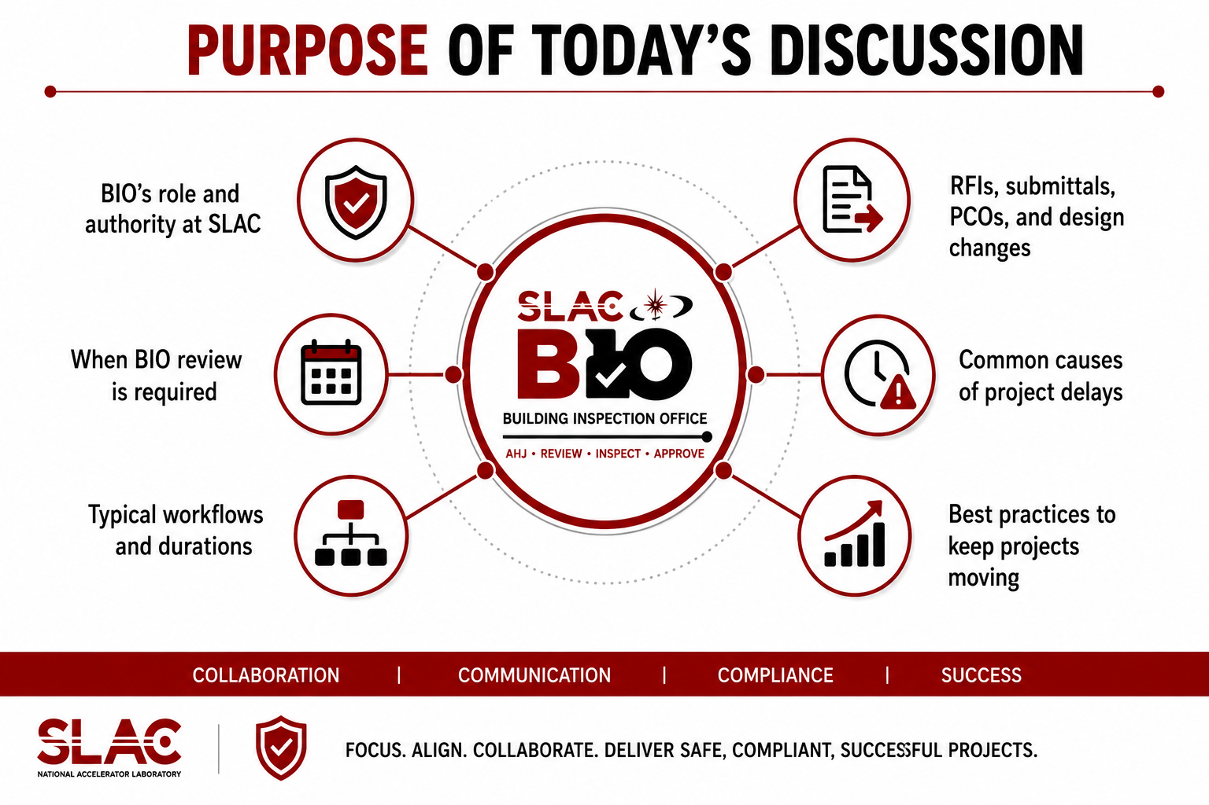

Purpose of Today’s Discussion
• RFIs, submittals, PCOs, and design changes
• Common causes of project delays
• Best practices to keep projects moving
• BIO’s role and authority at SLAC
• When BIO review is required
• Typical workflows and durations

Slide 3
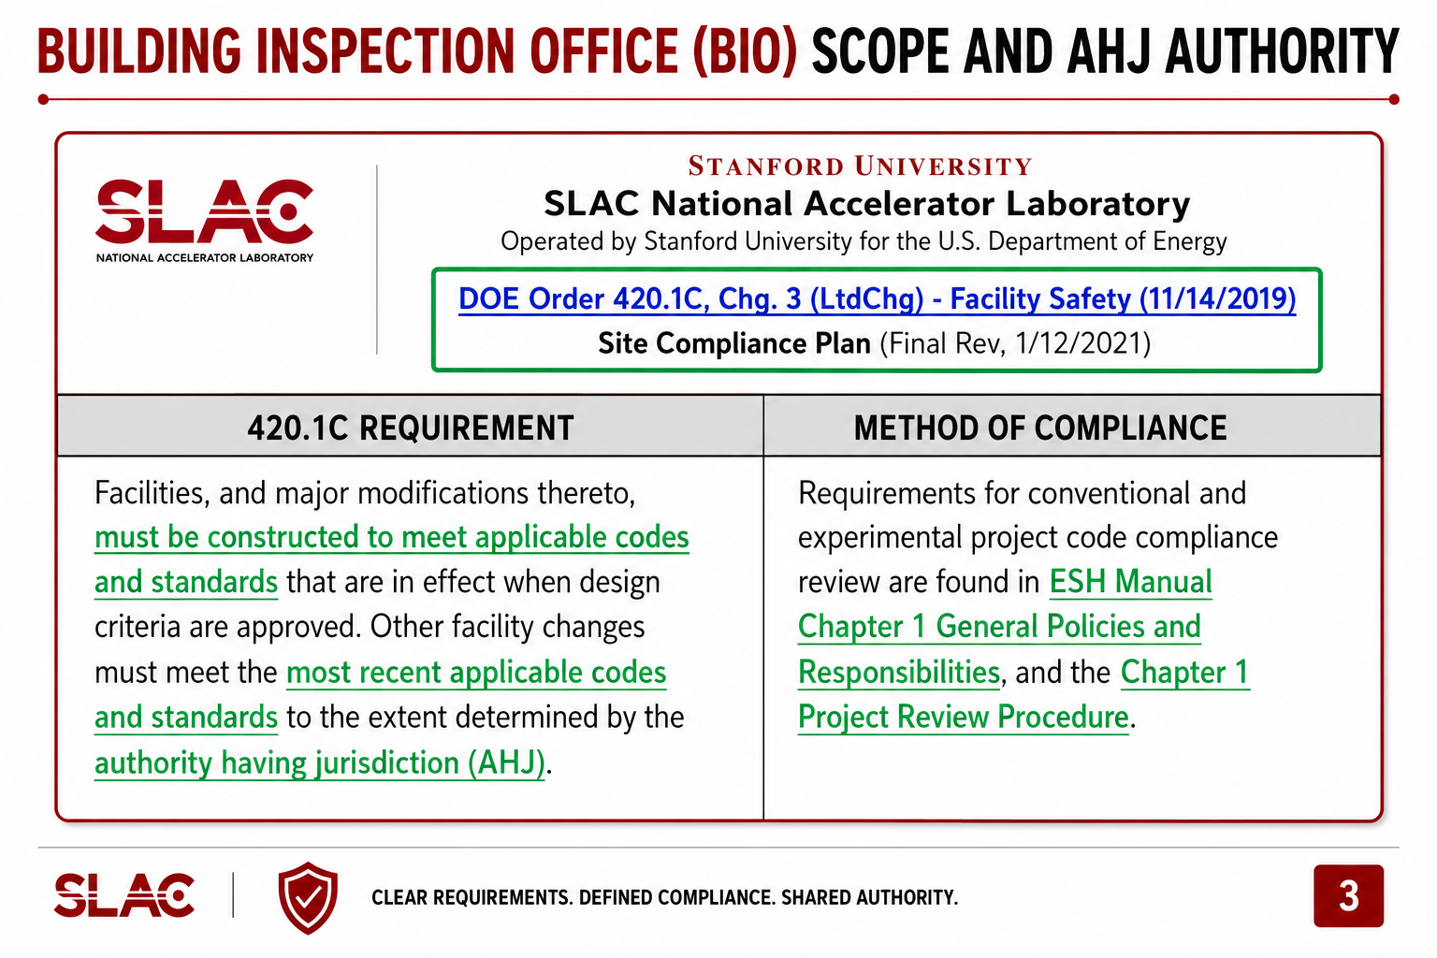
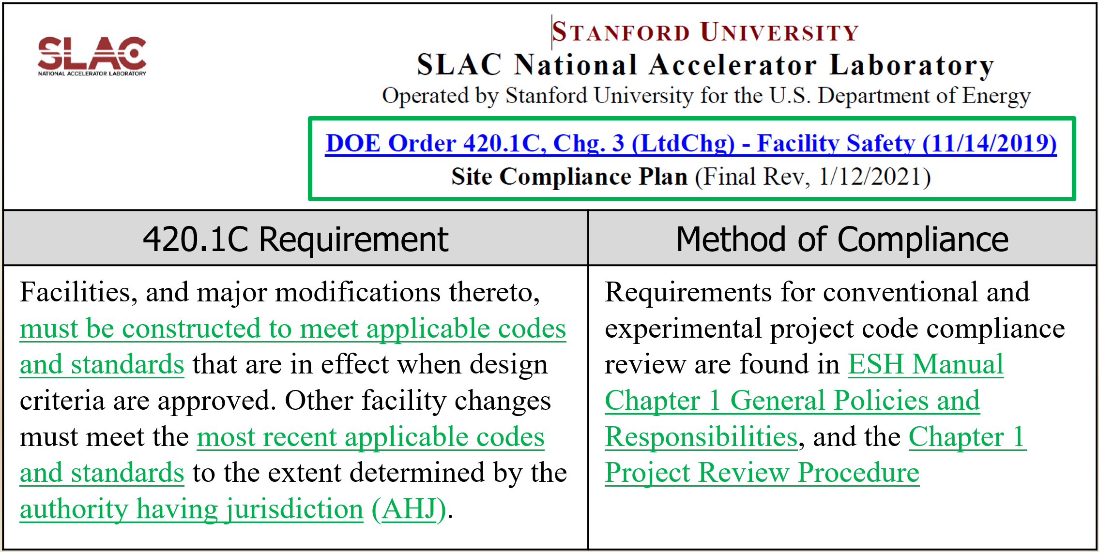
Building Inspection Office (BIO) Scope And AHJ Authority

Slide 4
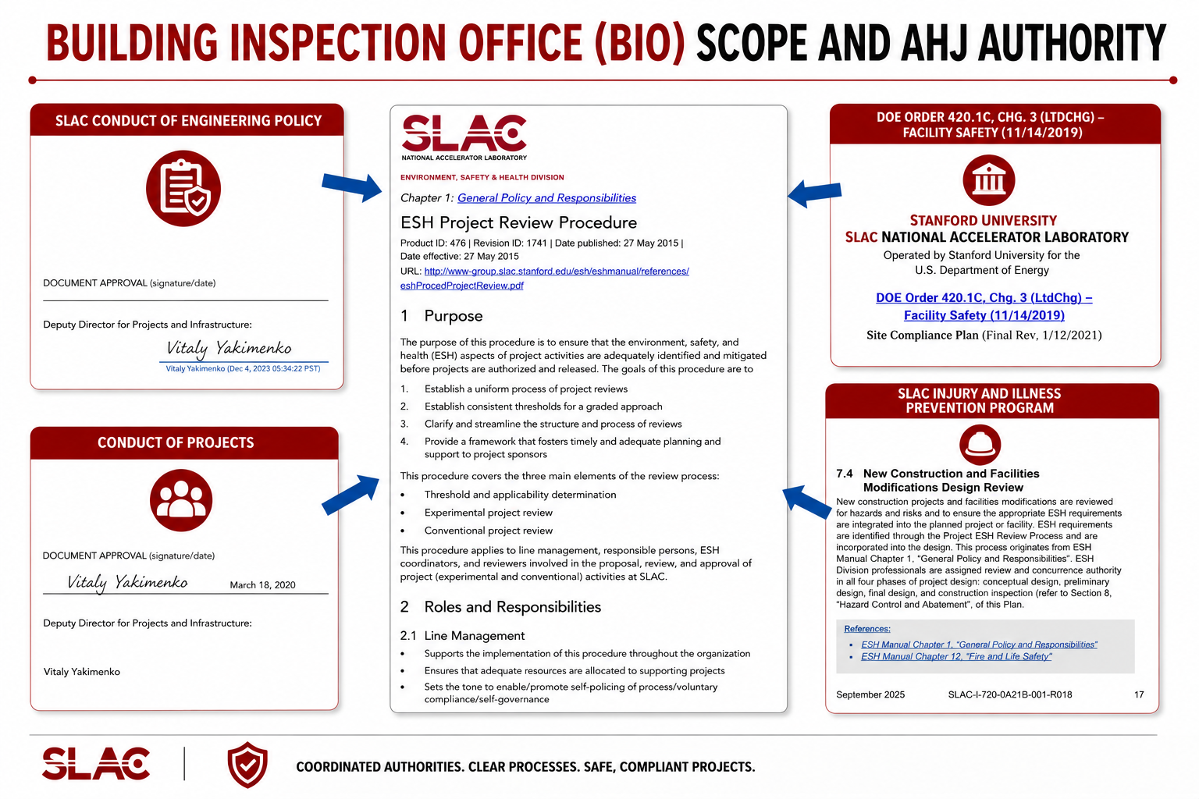
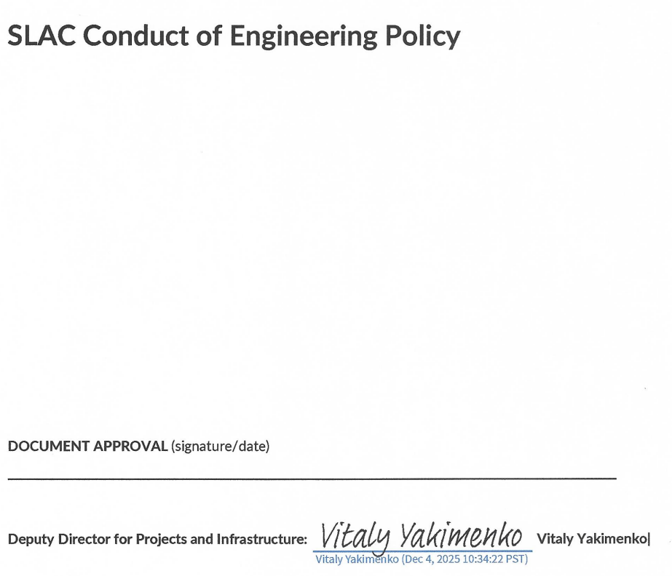
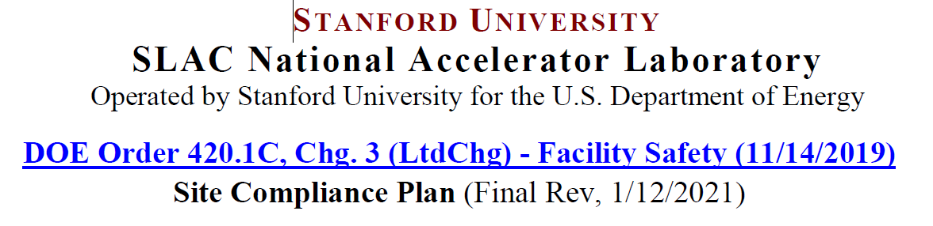
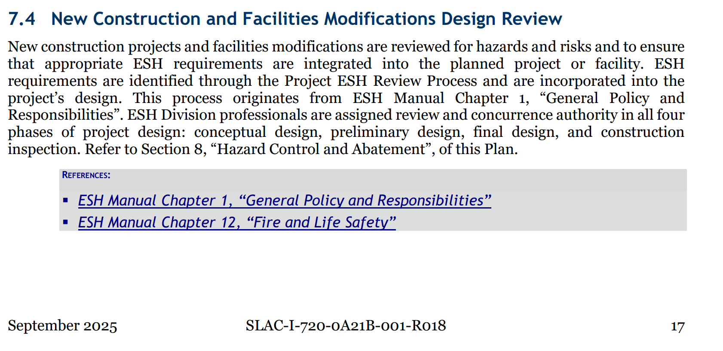
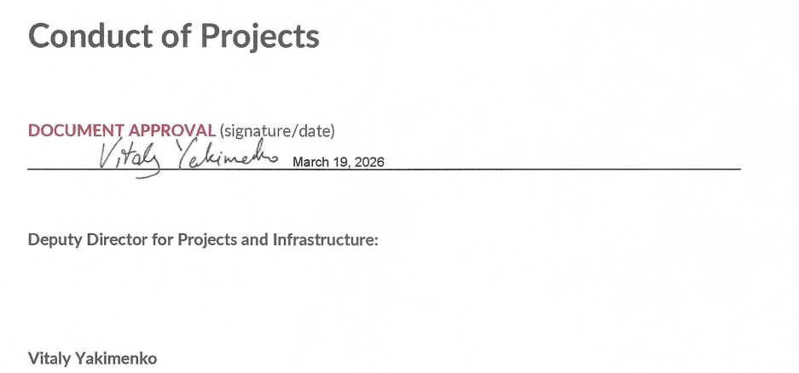
Building Inspection Office (BIO) Scope And AHJ Authority
SLAC Injury and Illness Prevention Program

Slide 5
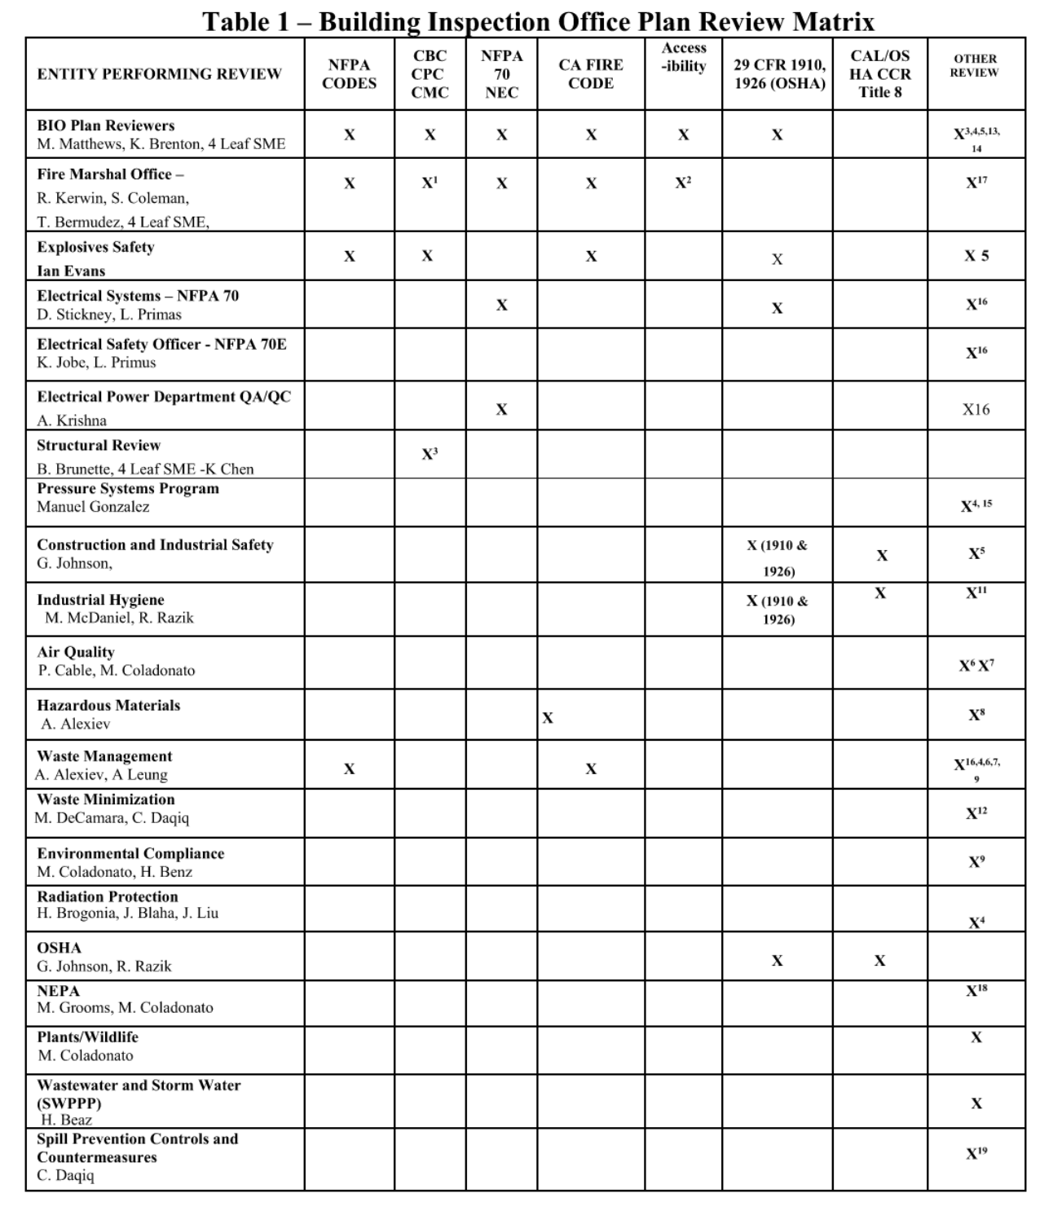
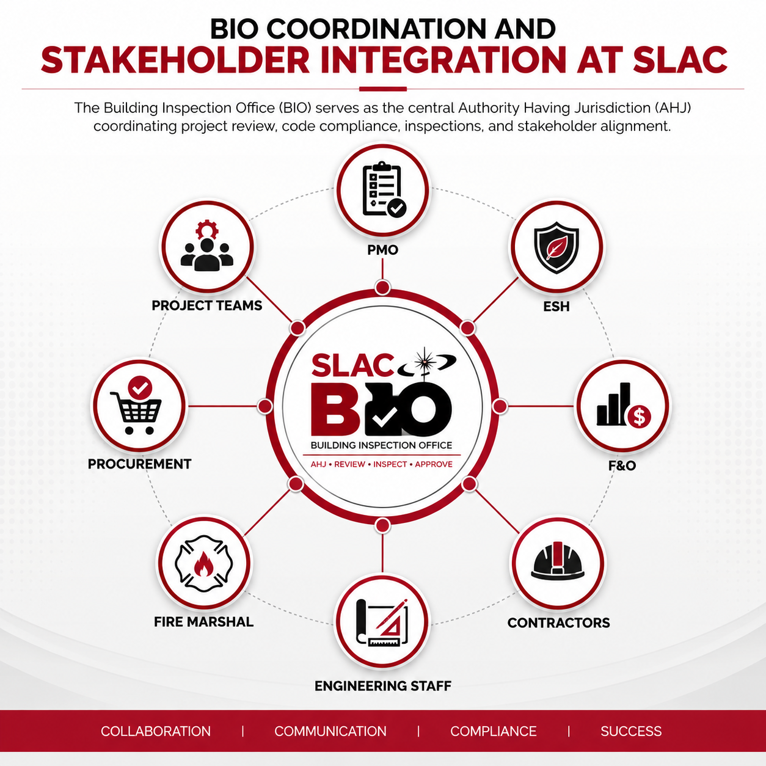
Building Inspection Office (BIO) Scope And AHJ Authority

Slide 6
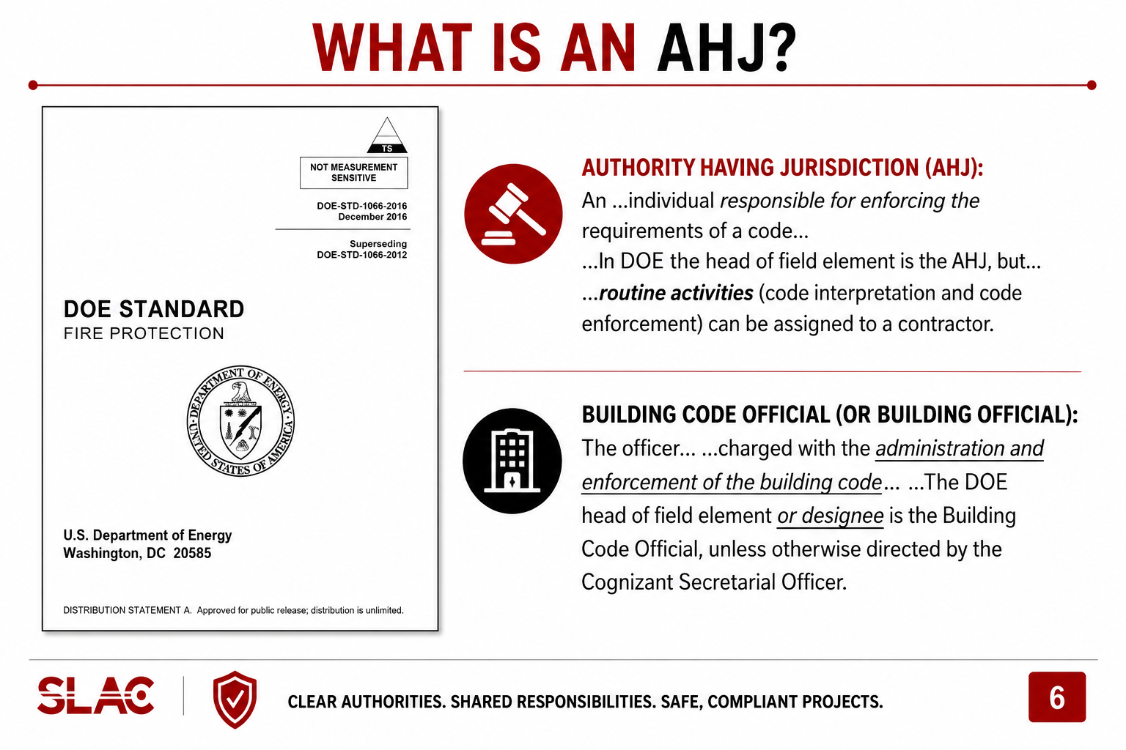
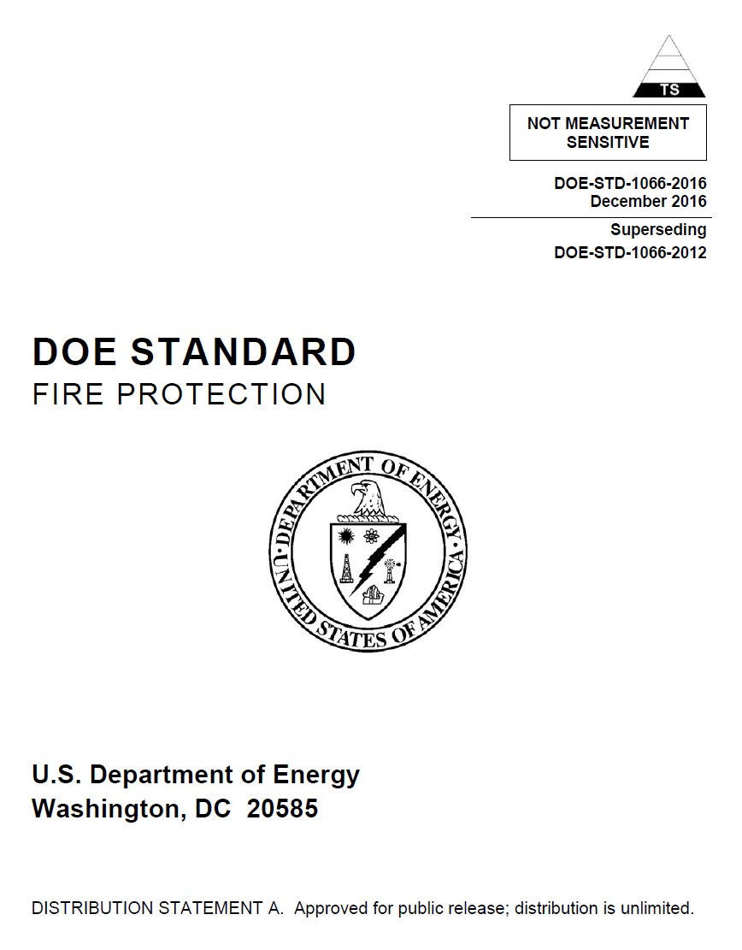
What is an AHJ?
Authority Having Jurisdiction (AHJ): An …individual responsible for enforcing the requirements of a code… …In DOE the head of field element is the AHJ, but… …routine activities (code interpretation and code enforcement) can be assigned to a contractor.
Building Code Official (or Building Official): The officer… …charged with the administration and enforcement of the building code… …The DOE head of field element or designee is the Building Code Official, unless otherwise directed by the Cognizant Secretarial Officer.

Slide 7
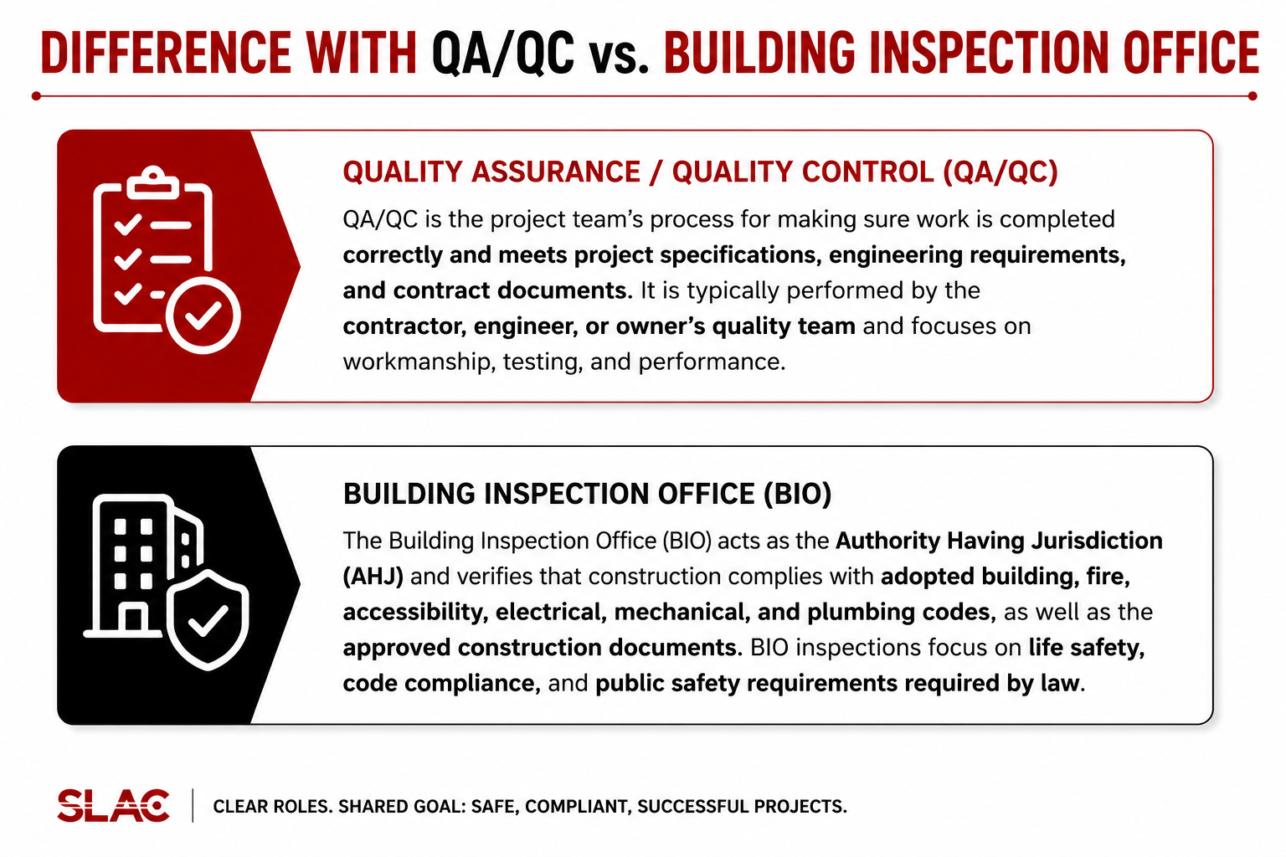
Difference with QA/QC vs. Building Inspection Office
Quality Assurance / Quality Control (QA/QC)
QA/QC is the project team’s process for making sure work is completed correctly and meets project specifications, engineering requirements, and contract documents. It is typically performed by the contractor, engineer, or owner’s quality team and focuses on workmanship, testing, and performance.
Building Inspection Office (BIO)
The Building Inspection Office (BIO) acts as the Authority Having Jurisdiction (AHJ) and verifies that construction complies with adopted building, fire, accessibility, electrical, mechanical, and plumbing codes, as well as the approved construction documents. BIO inspections focus on life safety, code compliance, and public safety requirements required by law.

Slide 8
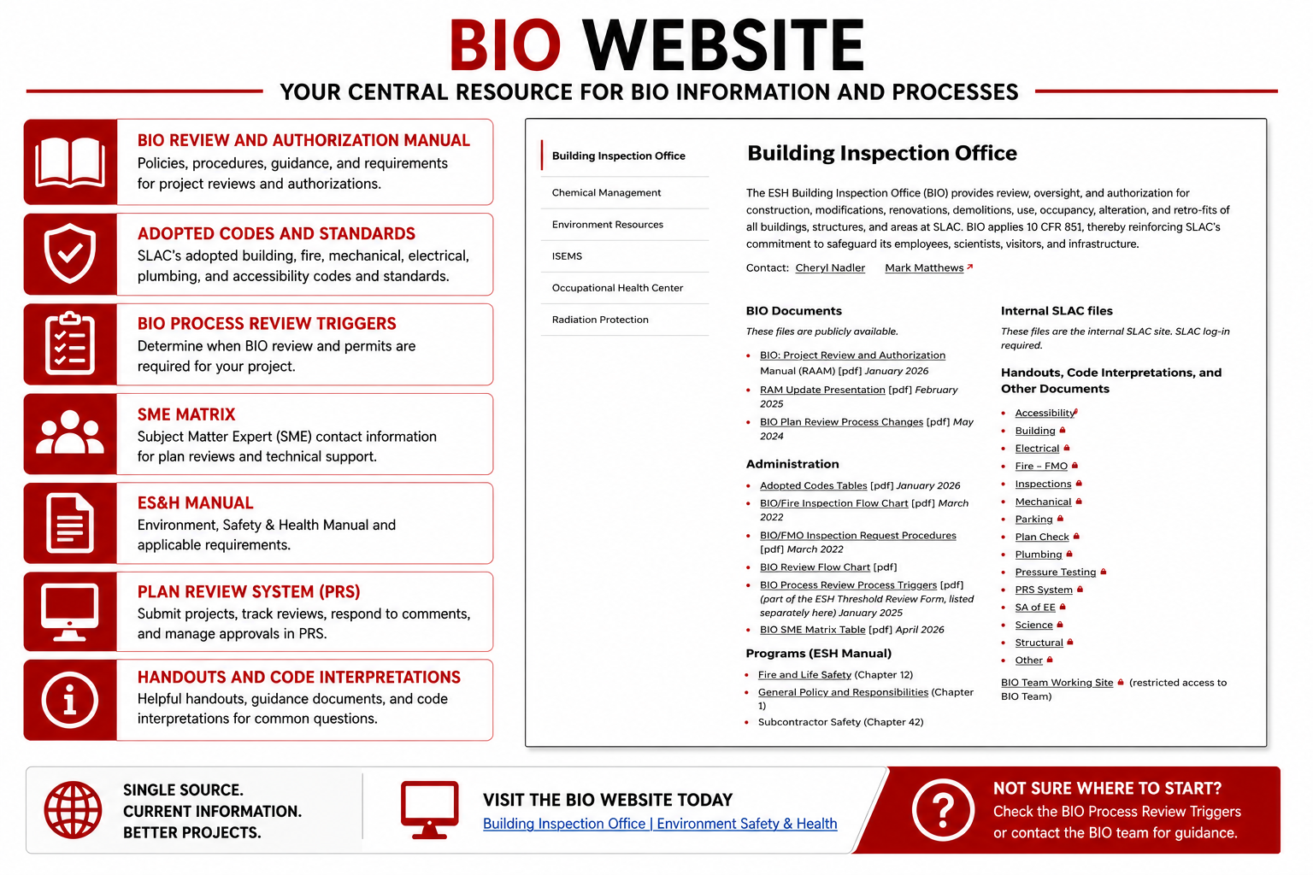
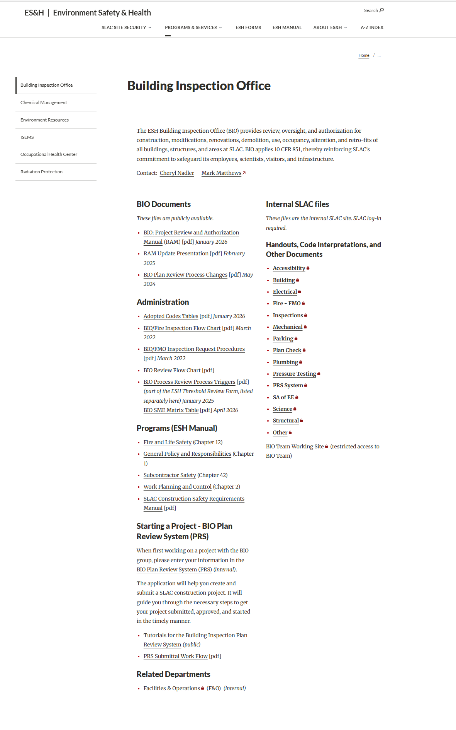
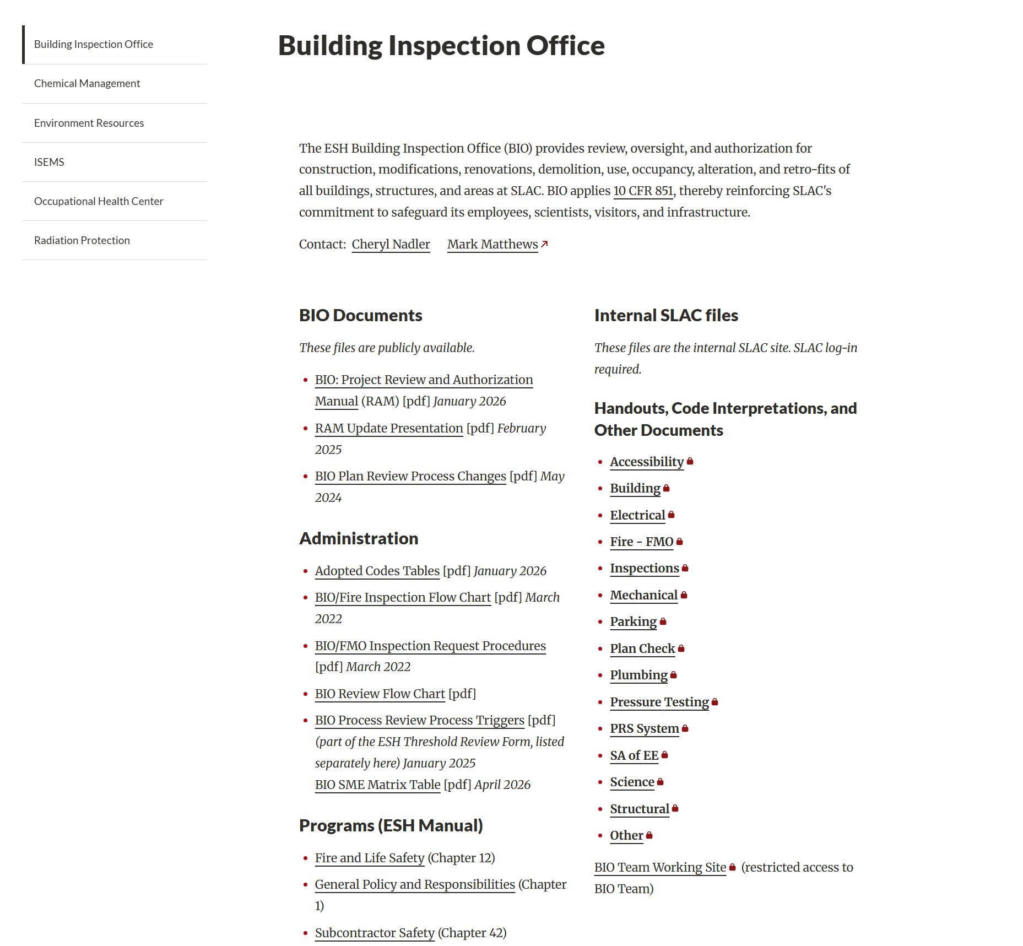
BIO Website
BIO Review and Authorization Manual
Adopted Codes and Standards
BIO Process Review Triggers
SME Matrix
ES&H Manual
Plan Review System (PRS)
Handouts and Code Interpretations
Building Inspection Office | Environment Safety & Health
VISIT THE BIO WEBSITE TODAY
Building Inspection Office | Environment Safety & Health

Slide 9
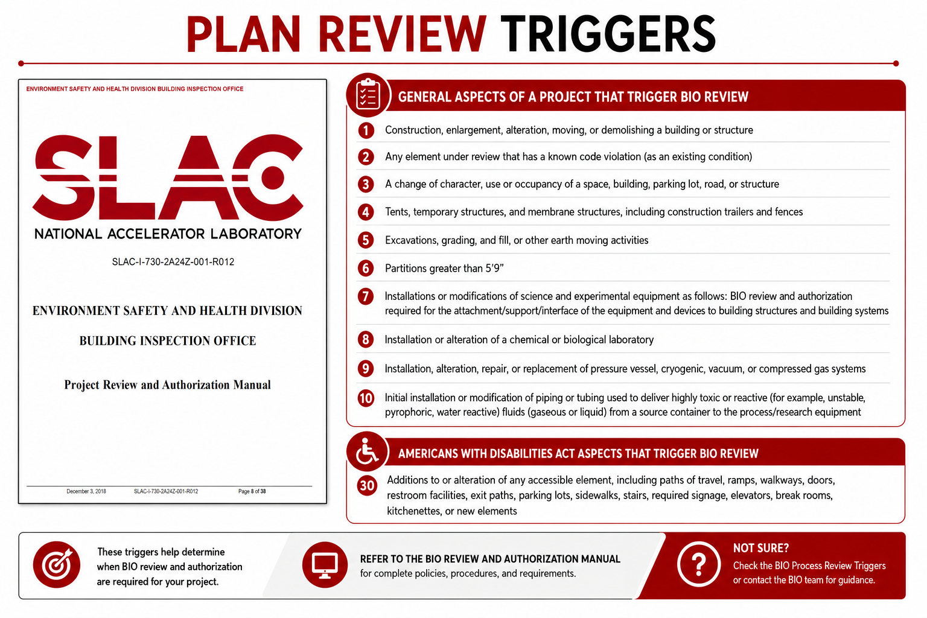
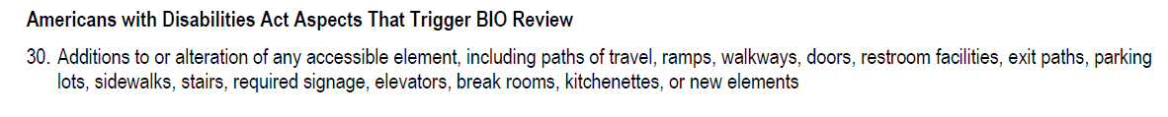
Plan review triggers

Slide 10
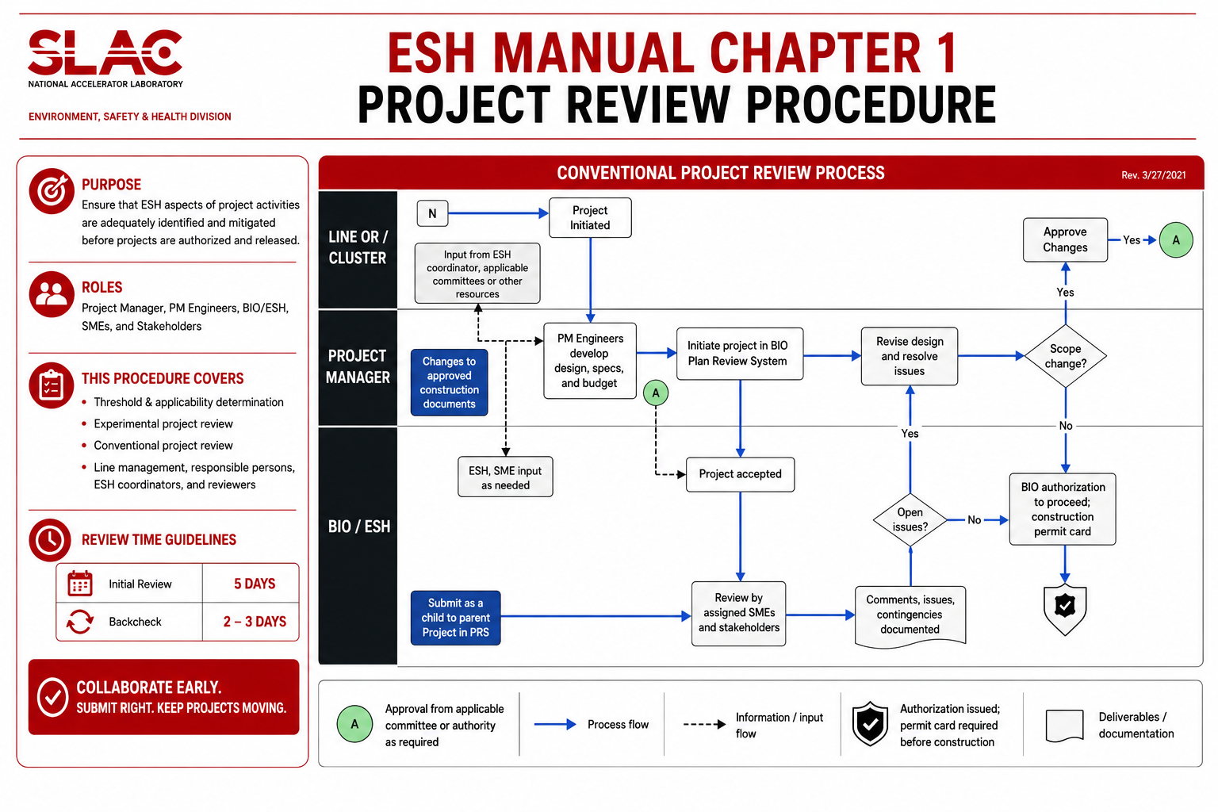
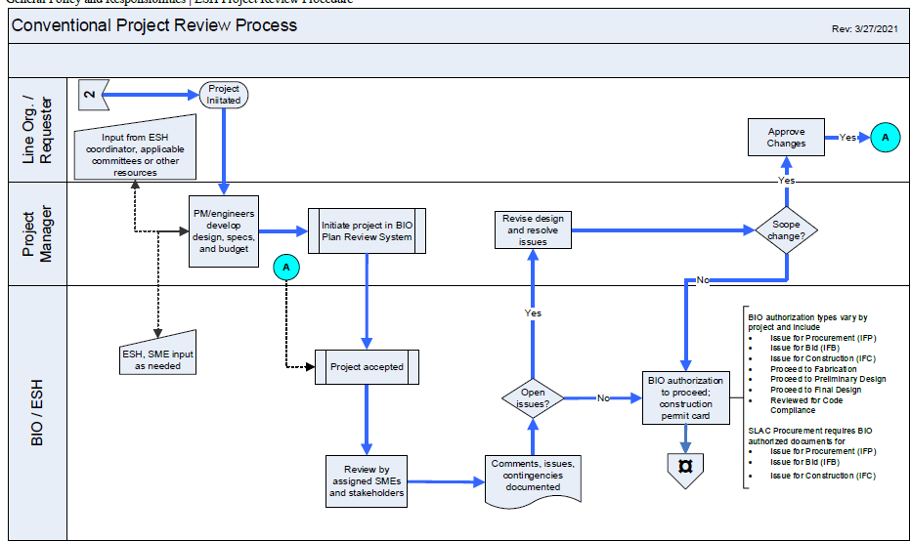
ESH Manual Chapter 1 Project Review Procedure
Line ORG/ Requester
Changes to approved construction documents
Submit as a Child to Parent Project in PRS
Initial review times is 5 days
Backcheck 2 to 3 days

Slide 11
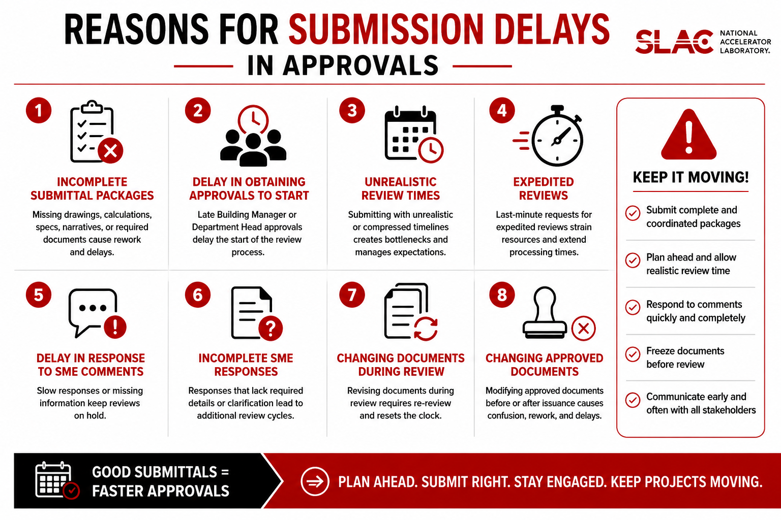
Common Reasons for Submission Delays In PRS

Slide 12
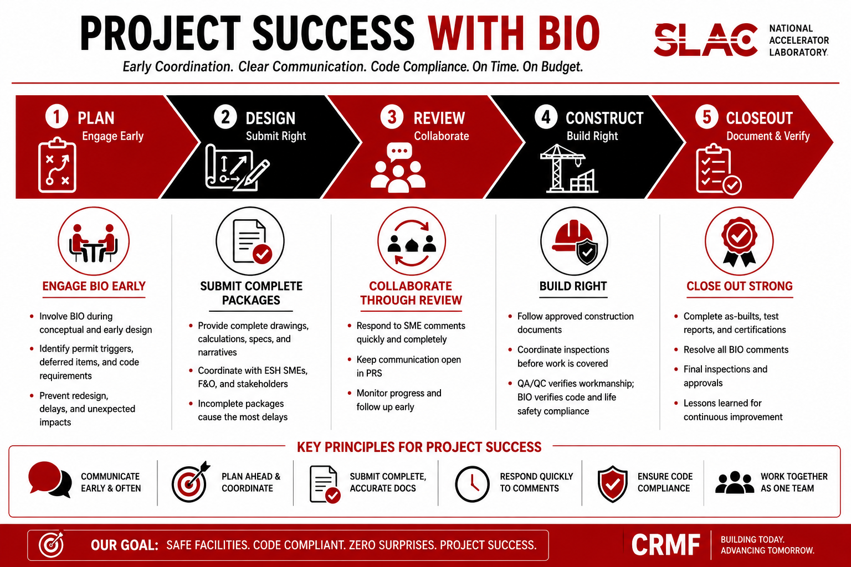
Best Practices for CRMF Project Success
Notes:
1. Engage BIO Early in Project Planning
• Bring BIO into the discussion during conceptual and early design phases
• Clarify permit triggers, deferred design items, and code requirements before design completion
• Early coordination prevents redesign, delays, and unexpected construction impacts
2. Submit Complete and Coordinated Packages
• Ensure drawings, calculations, specifications, and narratives are complete before submission
• Coordinate with ESH SMEs, F&O, and stakeholders before PRS upload
• Incomplete packages are one of the biggest causes of review delays
3. Understand What Requires BIO Review
• BIO reviews approved construction documents, design changes, deferred submittals, and permit scope changes
• Routine shop drawings and standard contractor submittals are generally not reviewed unless they modify approved design
• If unsure, ask BIO early
4. Lock the Design Before Construction
• Avoid starting procurement or field work with incomplete design information
• Complete power studies, utility coordination, delegated design requirements, and major engineering decisions early
• Late design changes often create RFIs, PCOs, and schedule impacts
5. Manage RFIs and Design Changes Effectively
• RFIs should clarify approved plans, not redesign the project in the field
• Any change to approved construction documents must return to BIO through PRS as a child project
• Design changes during construction almost always increase cost and schedule risk
6. Coordinate Weekly on Large or Complex Projects
• Hold regular coordination meetings for open RFIs, design changes, inspection hold points, and upcoming work
• Separate technical issue resolution from OAC meetings when needed
• Early communication reduces rework and confusion
7. Know the Difference Between QA/QC and BIO Inspections
• Contractor QA/QC verifies workmanship and specification compliance
• BIO verifies life safety, code compliance, and approved construction document compliance
• Passing QA/QC does not replace required BIO inspections
8. Plan for Inspections Before Work is Covered
• Coordinate inspection hold points early with BIO
• Do not cover work requiring inspection until approved
• Examples include structural elements, fire life safety systems, welding, waterproofing, and Chapter 17 special inspections
Key Takeaway

Slide 13
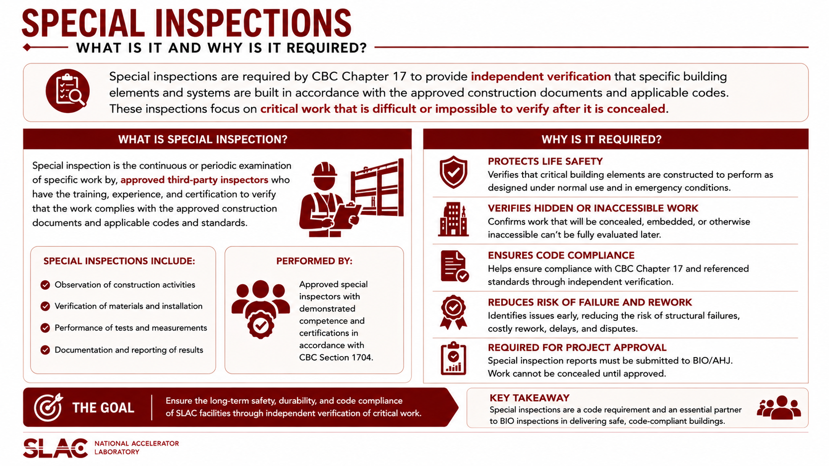

Slide 14
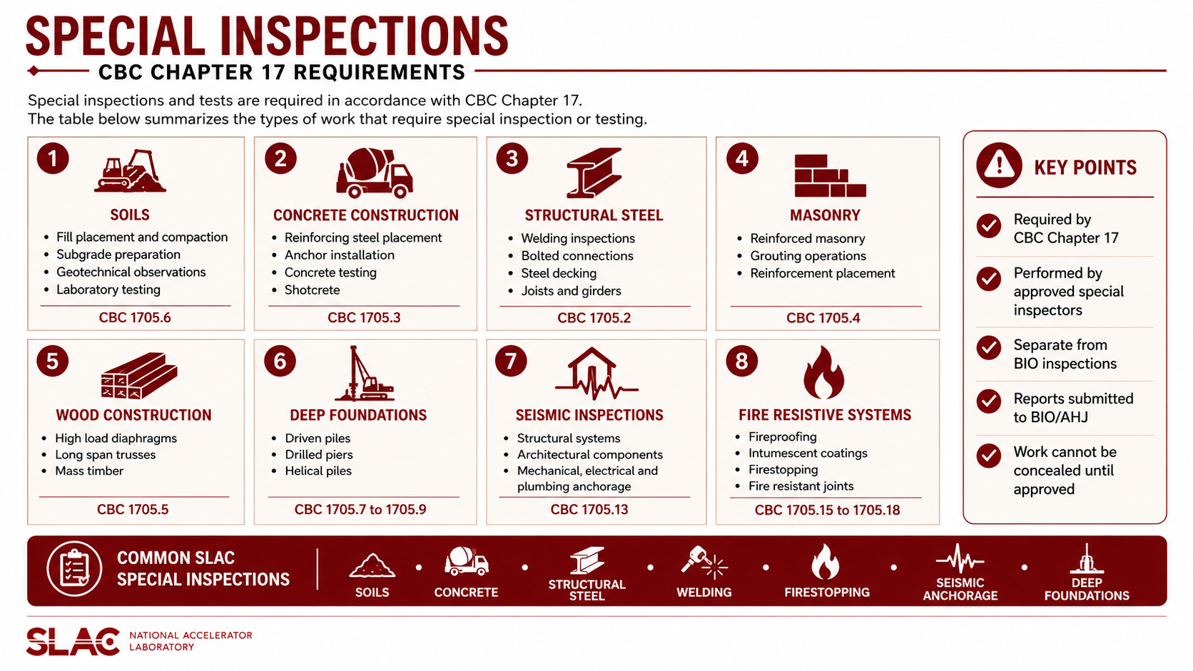

Slide 15
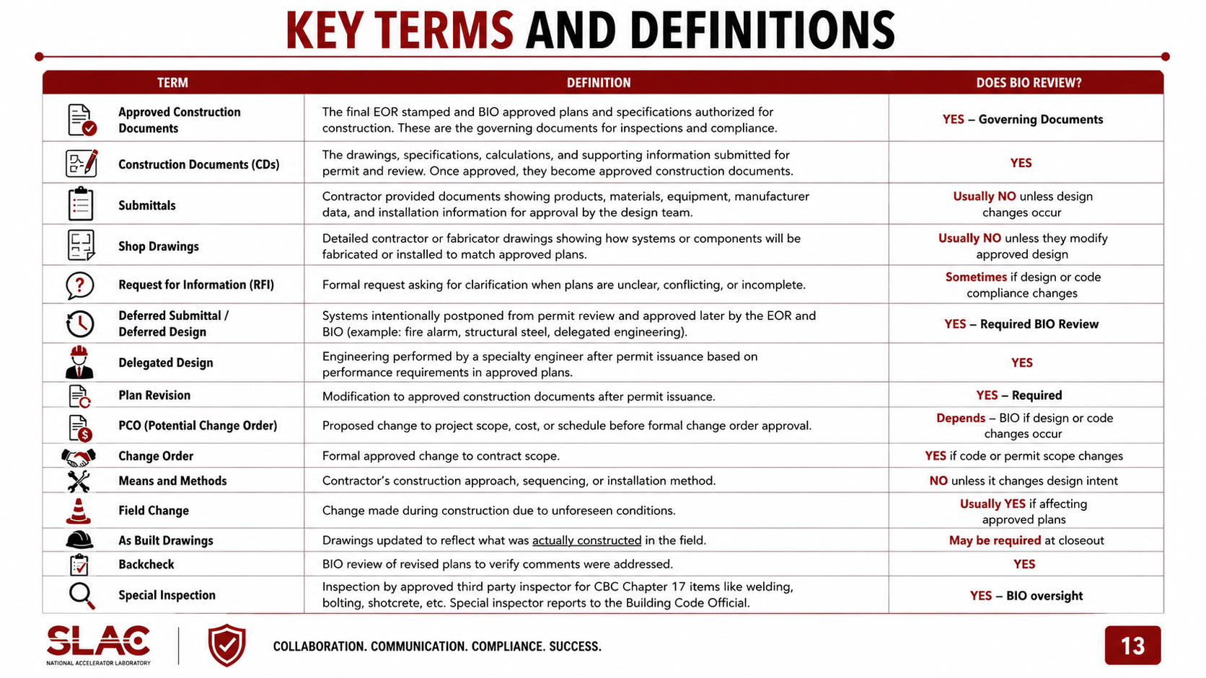
Terms and Definitions
Term | Definition | Does BIO Review?
Approved Construction Documents | The final EOR stamped and BIO approved plans and specifications authorized for construction. These are the governing documents for inspections and compliance. | YES – Governing Documents
Construction Documents (CDs) | The drawings, specifications, calculations, and supporting information submitted for permit and review. Once approved, they become approved construction documents. | YES
Submittals | Contractor provided documents showing products, materials, equipment, manufacturer data, and installation information for approval by the design team. | Usually NO unless design changes occur
Shop Drawings | Detailed contractor or fabricator drawings showing how systems or components will be fabricated or installed to match approved plans. | Usually NO unless they modify approved design
Request for Information (RFI) | Formal request asking for clarification when plans are unclear, conflicting, or incomplete. | Sometimes if design or code compliance changes
Deferred Submittal / Deferred Design | Systems intentionally postponed from permit review and approved later by the EOR and BIO (example: fire alarm, structural steel, delegated engineering). | YES – Required BIO Review
Delegated Design | Engineering performed by a specialty engineer after permit issuance based on performance requirements in approved plans. | YES
Plan Revision | Modification to approved construction documents after permit issuance. | YES – Required
PCO (Potential Change Order) | Proposed change to project scope, cost, or schedule before formal change order approval. | Depends – BIO if design or code changes occur
Change Order | Formal approved change to contract scope. | YES if code or permit scope changes
Means and Methods | Contractor’s construction approach, sequencing, or installation method. | NO unless it changes design intent
Field Change | Change made during construction due to unforeseen conditions. | Usually YES if affecting approved plans
As Built Drawings | Drawings updated to reflect what was actually constructed in the field. | May be required at closeout
Backcheck | BIO review of revised plans to verify comments were addressed. | YES
Special Inspection | Inspection by approved third party inspector for CBC Chapter 17 items like welding, bolting, shotcrete, etc. Special inspector reports to the Building Code Official | YES – BIO oversight

Slide 16

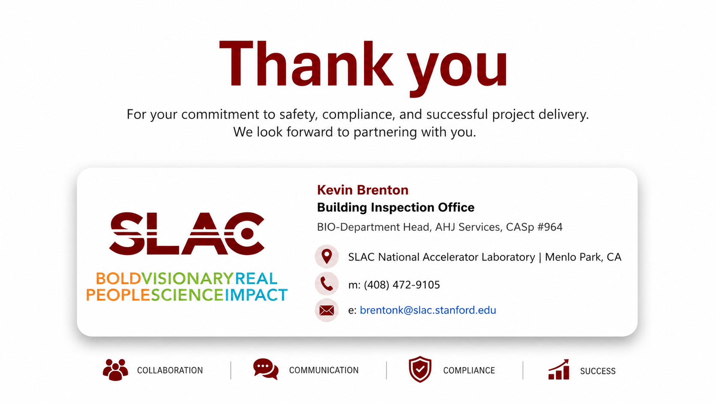

Thank you

